Slide 1


ElasticTrainer: Speeding Up On-Device Training with Runtime Elastic Tensor Selection
Kai Huang, Boyuan Yang, Wei Gao
University of Pittsburgh
ACM MobiSys 2023

Slide 2

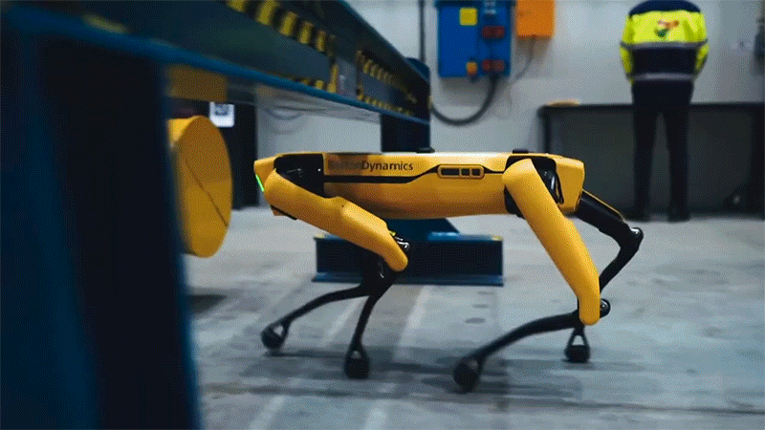
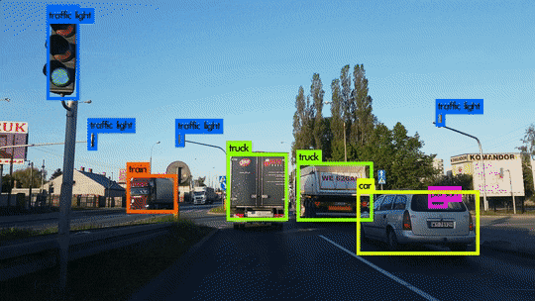

AI models should constantly learn
Promptly adapt to new online data and ever-changing environment
Category-extensible object detector
Mobile auto-suggestion
All-terrain legged robot
Recent chat history with new friends
Leg torque readings on unseen terrains
Snapshot of new vehicle models
Mimic your new tone
Adjust motor to stabilize body
Accurate scene perception
Notes:
These days, AI models should constantly learn and promptly adapt to new online data and the ever-changing environment. For example:
[x] Mobile auto-suggestion algorithms should learn from user’s recent chat history, in order to provide relevant suggestions.
[x] Legged robots must learn from the feedback of motion sensors, so as to adjust motors to stabilize their bodies.
[x] In autonomous driving, object detector should be able to learn to recognize new object categories, to ensure accurate perception of road conditions.

Slide 3




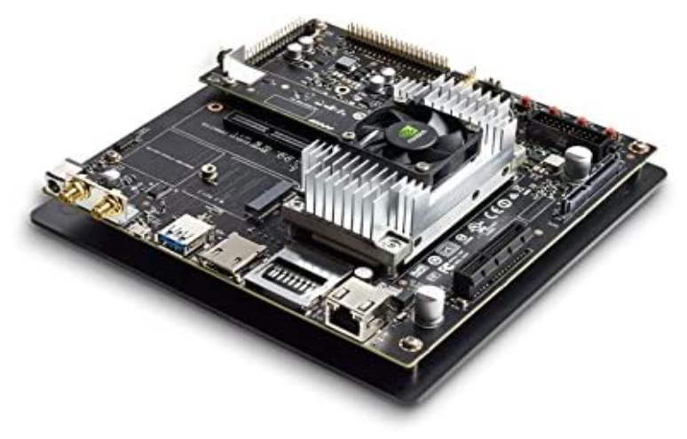
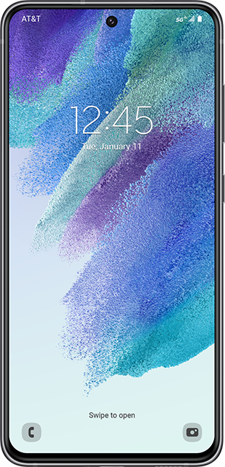


On-device model training is essential
When data privacy & timeliness of adaptation matter …
offload
On-cloud training?
On-device training !
Notes:
To enable continual training of AI models, cloud-based training requires users to transmit either raw data or high-volume of intermediate training results between local device and cloud, which becomes infeasible when data privacy and the timeliness of adaptation matter, especially for embedded devices with low-speed radios.
[x] On-device training, therefore, becomes an essential technique by completely retaining the training process at local, preventing data leakage and wireless transmission.

Slide 4

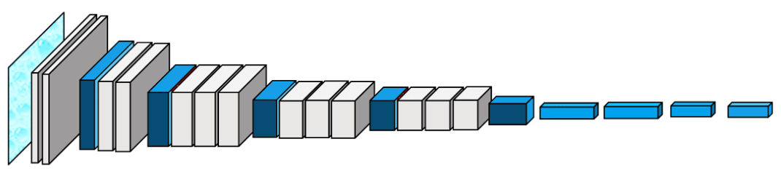
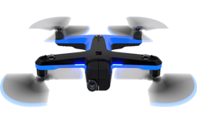
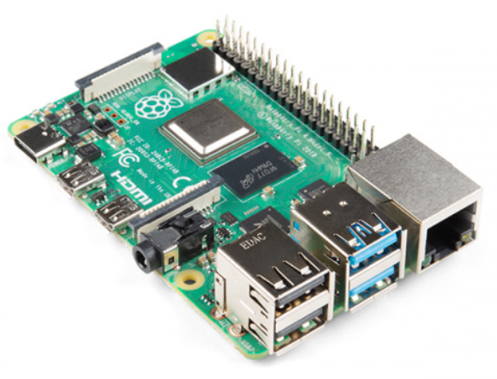
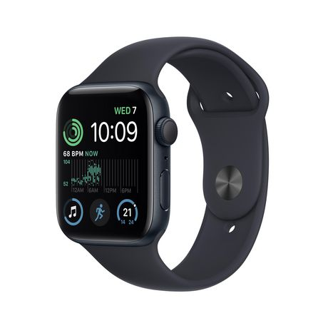



On-device training is expensive and slow
ResNet / VGG model
runtime feeding
6,000 images
Mobile GPU Platforms:
Mobile CPU Platforms:
Nvidia Jetson, High-end smartphones, …
Raspberry Pi, Wearables, …
~16 hours
~30 days
Notes:
However, training neural networks on resource-constrained mobile and embedded devices can be a significant challenge due to the limited on-device computing power.
For example, to train a ResNet or a VGG model for image recognition using 6000 training images, it can take up to 16 hours on high-end mobile GPU platforms like Nvidia Jetson or the latest smartphones. On lower-end mobile CPU platforms like Raspberry Pi or wearables, it can further take over 30 days, which is incredibly slow. This motivates us to develop efficient training schemes for faster execution given limited on-device computing resources.

Slide 5

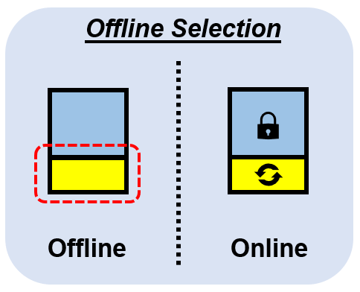
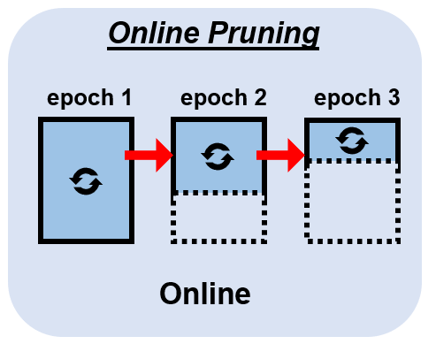
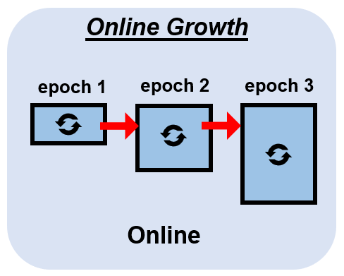
Existing work to speed up on-device training
Offline Selection
Offline select a fixed NN portion
Cannot adapt to new data & training progress
Online Pruning
Runtime remove unimportant portions
Unrecoverable, keep losing expressiveness
Online Growth
Runtime append new NN portions
Cannot start from a strong pretrained model
Newly added portions must train from scratch
Notes:
[x] To speed up on-device training, existing offline selection schemes only select important NN portions, such as last a few layers, to be online trainable. But the selected portion is fixed and cannot adapt to new data & training progress.
[x] Instead, NN punning removes unimportant NN substructures on the fly to gradually reduce training cost. But the pruned structure is unrecoverable and the NN keeps losing representational power over time.
[x] Alternatively, online growth starts from a small NN and keeps adding new NN portion at runtime. But it cannot start from a strong pretrained model. The newly added portions require training from scratch and takes extra time.

Slide 6

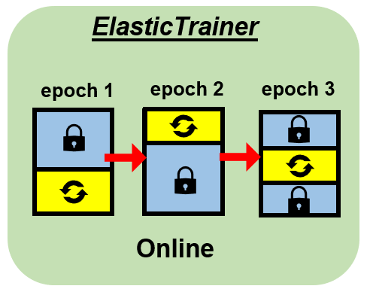


Elastic Selection for On-device Training
Elastic Selection: NN substructures can be freely removed from or added to trainable portions during training.
Layer 1
Layer 2
Layer 3
Layer 4
Layer 5
Notes:
To overcome the weaknesses of existing work, we propose ElasticTrainer. Our basic idea is that the selection of NN portions should be full elastic.
[x] In other words, every NN substructure can be freely removed from or added to the trainable NN portions at any time. In this way, the model architecture and the representational power can be fully reserved, while the computational cost can still be optimized, by selecting the most important NN substructures for training.

Slide 7

Selection Granularity – Tensor Level
NN layer
NN weights
Input
Output
Layer-level: inaccurate, selected layer may contain many unimportant weights
Weight-level: cannot accelerate, fine-grained indexing is not supported by tensorized NN libraries
Tensor-level: can be efficiently executed by existing NN library with moderate granularity
Notes:
The optimality of substructure selection, however, is affected by the granularity of selection, which can be at the level of layers, weights and tensors. For example, given a neural network with three dense layers, each layer contains two trainable tensors as groups of weights, which multiply and add to the input data respectively.
[x] The layer-level selection is coarse-grained and hence inaccurate, because many unimportant weights within a layer may cause some important weights in the same layer not to be selected.
[x] On the other hand, although the weight-level selection is the most fine-grained, it requires fine-grained indexing of weights, which cannot be efficiently executed by existing tensorized NN libraries, such a tensorflow and pytorch.
[x] Hence, ElasticTrainer adopts tensor-level selection, which ensures accuracy and can also be efficiently executed in existing NN frameworks without extra overhead.

Slide 8

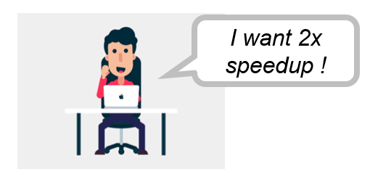
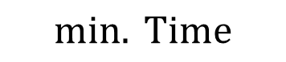
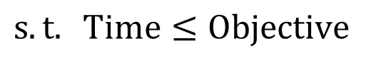
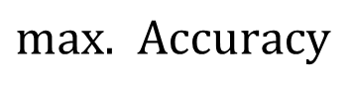
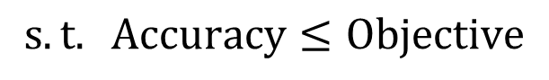
Problem Formulation of Elastic Tensor Selection
70%
Minimize training time with the accuracy objective
$$min. Time$$
$$s.t. Accuracy≤Objective$$
80%
90%
Hard to decide appropriate accuracy objective in advance
Speedup is not guaranteed
Best possible accuracy = 85%
Unknown beforehand
Maximize accuracy with the speedup objective
$max.$ $Accuracy$
$$s.t. Time≤Objective$$
Make best effort to maximize accuracy anyway
Speedup is under control
Notes:
To select the optimal set of NN tensors, an intuitive formulation of the speedup problem is to minimize the training time with respect to the required NN training quality, which is measured by the trained NN model’s prediction accuracy.
[x] However, it is hard to decide the appropriate accuracy objective without knowing the best achievable accuracy beforehand.
[x] If the accuracy objective is set too high, there will be no speed-up.
[x] Instead, ElasticTrainer opts to maximize the accuracy with the best effort with the speedup objective. The user can control desired wall-clock time speed-up based on application demand.

Slide 9
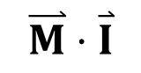
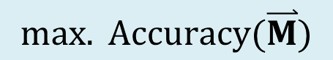
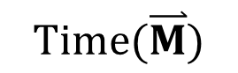
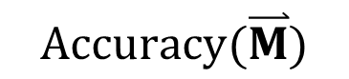
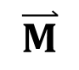
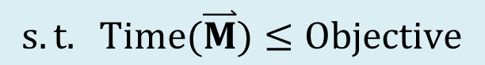
Problem Formulation of Elastic Tensor Selection
Maximize the accuracy at best-effort with the wall-clock time speedup objective
$$max. Accuracy(\overset{⃑}{M})$$
$$s.t. Time(\overset{⃑}{M})≤Objective$$
binary selector
0
0
1
1
0
1
… …
$$\overset{⃑}{M}$$
[0 0 1 1 0 1 …]
$$Accuracy(\overset{⃑}{M})$$
$$\overset{⃑}{M}⋅\overset{⃑}{I}$$
Cumulative importance of selected tensors
$$Time(\overset{⃑}{M})$$
Time of training selected tensors
Challenge 1: How to adaptively evaluate tensor importance at runtime?
Challenge 2: How to construct time model of NN training?
Challenge 3: How to efficiently solve selection problem at runtime?
Notes:
By choosing such formulation, specifically,
[x] we try to solve a binary selector that indicates whether to select a tensor to be trainable or not.
[x] Since it is computationally expensive to evaluate model’s prediction accuracy under different selections, we instead look for a tensor importance metric that allows us to estimate training quality using simple linear combination of the binary selector.
[x] The training time of the selected tensors is also parametrized by the binary selector.
[x] To solve this selection problem, we need to address three challenges:
How to adaptively evaluate tensor importance at runtime?
How to construct time model of NN training?
How to efficiently solve selection problem at runtime?

Slide 10
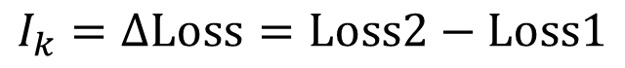
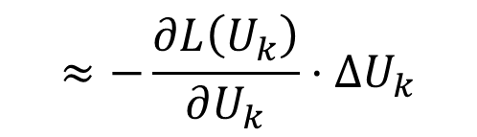
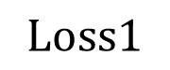
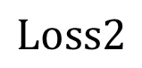
Solving Challenge 1: Evaluating Tensor Importance
Key Insight: tensor importance changes at runtime
Well-trained tensors are less prioritized for selection
Well-trained tensors on old data may need further training on new online data
Metric Definition: how much training loss will increase back, if undo its update
Tensor 1
Tensor 2
Tensor k
Tensor N
Original
Updated
$$Loss1$$
Undo update of tensor k
$$Loss2$$
$$≈−\frac{∂L\left(U_{k}\right)}{∂U_{k}}⋅ΔU_{k}$$
Periodically evaluate with sampled training data
$$I_{k}=ΔLoss=Loss2−Loss1$$
Notes:
To solve the first challenge, our key insight is that the tensor importance metric should capture the importance variation, with respect to training progress and the novelty of online data patterns. For example, as training proceeds, some already well-trained tensors can skip further training, so their selection is less prioritized and hence the importance becomes lower. On the other hand, these well-trained tensors on old data may still need further training on new online data.
[x] To capture such runtime variations, we define our tensor importance as
[x] how much training loss will increase back if undo its update during training.
[x] With modern NN libraries, the importance of all the NN tensors can be computed in one shot with gradient-based approximation.
[x] At runtime, we periodically compute tensor importance with randomly sampled training data.

Slide 11

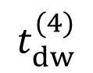
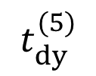
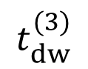
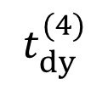
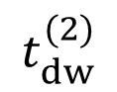
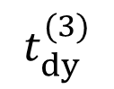
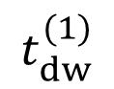
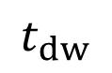
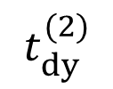
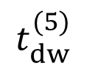
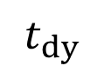
Solving Challenge 2: Construct Tensor-level Time Model
First look at the time model of layer-level selection
$$t_{dw}^{(1)}$$
$$t_{dw}^{(2)}$$
$$t_{dw}^{(3)}$$
$$t_{dw}^{(4)}$$
$$t_{dw}^{(5)}$$
1
2
3
4
5
Input
Pred.
$$t_{dy}^{(2)}$$
$$t_{dy}^{(3)}$$
$$t_{dy}^{(4)}$$
$$t_{dy}^{(5)}$$
Label
Per-layer weights
$$t_{dy}$$
Time of propagating error gradient
Forward pass
$$t_{dw}$$
Time of computing weight update from error gradient
Backward pass
Can this model generalize to tensor-level selection?
Time to include when only training layer (3)
Notes:
To solve challenge of constructing the tensor-level time model, our basic idea is to start from the layer level and try to make generalization.
[x] Given a 5-layer NN, during training,
[x] the NN will first do a forward pass to get prediction results and compute the loss function with labels.
[x] Then in the backward pass, the error gradients will go through every layer for weight update. Overall, the total backward time contains two parts,
[x] the time of propagating error gradient, referring to tdy,
[x] and the time of computing weight update from error gradient, referring to tdw.
[x] Suppose we only want to select layer 3 for training in this example, the total backward time should be tdw3 plus the time to passing error gradient tdy4 and tdy5.
[x] Based on the layer-level time model, our question is: can the same rule apply to tensor level selection?

Slide 12
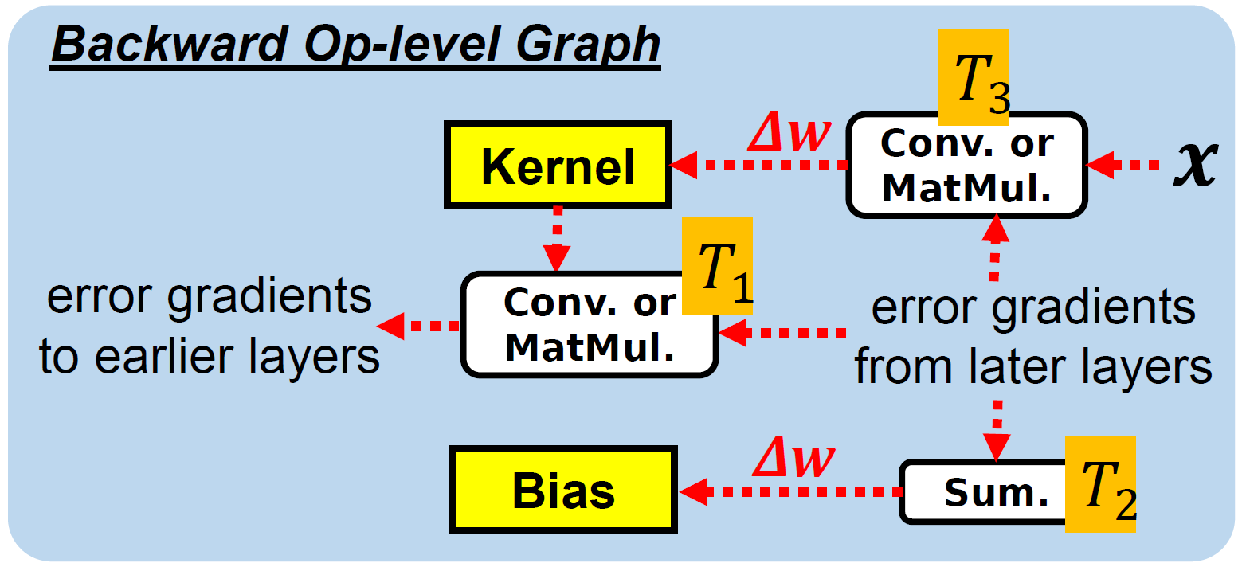
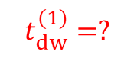

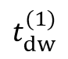
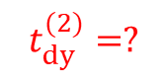
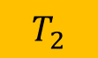
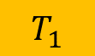
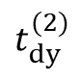
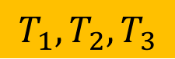
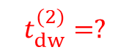
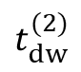
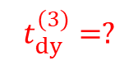
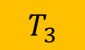
Solving Challenge 2: Construct Tensor-level Time Model
(1) Consider each tensor as a layer. (2) Associate with related operator timings
$$t_{dw}^{(1)}$$
$$t_{dw}^{(2)}$$
Layer 1
Layer 2
Kernel
Bias
$$t_{dy}^{(2)}$$
Kernel
Bias
Unroll
Layer 1
Layer 2
Layer 3
Layer 4
Kernel
$$t_{dy}^{(2)}=?$$
Bias
$$t_{dy}^{(3)}=?$$
Kernel
Bias
$$0$$
$$T_{1}$$
$$t_{dw}^{(1)}=?$$
$$t_{dw}^{(2)}=?$$
$$T_{3}$$
$$T_{2}$$
$$T_{1},T_{2},T_{3}$$
Timing of Related Operators
Notes:
To make such generalization,
[x] we consider each tensor as a layer, and unroll all the NN tensors into a layer-based representation.
[x] To determine the tensor timings, we extract the timings of related operations in the backward computing graph, which are then matched and aggregated to the corresponding tensors.
In our work, we apply such rationale to obtain the tensor timing model for different types of layers, such as convolutional, dense, batch normalization and non-trainable layers.

Slide 13




Solving Challenge 3: Tensor Selection with Dynamic Programming
Tensor Selection Problem is NP-hard !
Start from solving easier sub-problems:
Objective $≤t$
P[k = 1, t = 1]
P[k = 1, t = 2]
P[k = 2, t = 1]
Backward Depth $≤k$
P[k = N, t = Objective]
Find recurrence relations between sub-problems:
e.g.,
If $k^{th}$ tensor is not selected, then P[k, t] will fall back to P[k-1,t].
Notes:
With the time model and evaluated tensor importance scores, we can ground the tensor selection problem as a constrained optimization problem. Due to its NP-hardness, we want to use dynamic programming to solve it in pseudo polynomial time.
[x] The basic idea is to start from solving easier sub-problems by reducing the depth and objective of backward pass. We can obtain the solution to the original problem by recursively solving all the subproblems.
[x] The recurrence relations of subproblems can be found by discussing the cases of whether the new tensor in the current subproblem is selected or not.
For example, if the new tensor is not selected, then the current subproblem can be fall back to the previous subproblem and share the same solution. Please refer to our paper for more case discussion and detailed algorithms.

Slide 14


Putting them together
Tensor Timing Profiler
Tensor Importance Evaluator
Training data
Layer 1
Layer 2
Layer 3
Pred.
Label
NN
Tensors
Tensor-level Graph
Tensor Importances
Loss
Layer 1
Layer 2
Layer 3
Tensor Timings
Tensor Selector
$$\max{ \vec{M}⋅\vec{I}}$$
Sub-problem Space
$$s.t. T_{sel}(\vec{M})≤ρT_{full}$$
P1
P5
P10
Standard Profiler
Optimal Selection Strategy (M)
Operator timings
Sub-problem definition
DP
P20
Notes:
After addressing these challenges, we put all the modules together.
[x] At offline stage, the tensor timing profiler constructs tensor timings by matching and aggregating timings of relevant NN operators [x].
[x] At online stage, the tensor importance evaluator keeps monitoring tensor importance.
[x] The tensor timings and importance scores are sent to the tensor selector to produce the optimal selection strategy using dynamic programming at runtime

Slide 15


Implementation & Evaluation Setup
Devices for NN training
GPU Platform: Nvidia Jetson TX2 + SATA SSD
CPU Platform: Raspberry Pi 4B
Training code is implemented using TensorFlow
Baselines
Full training: train all NN weights
Traditional TL [1, 2]: train only last a few prediction layers
BN + Bias [3, 4]: train bias weights & batch normalization layers
PruneTrain [5]: online pruning
Large variance in the same category, small variance in different categories
Models & Datasets
ResNet50, VGG16, MobileNetV2, Vision Transformer
CUB-200, Stanford Dogs, Oxford Pets for fine-grained image classification
[1] J. Donahue et al. Decaf:A deep convolutional activation feature for generic visual recognition. ICML 2014
[2] K. Simonyan et al. Very deep convolutional networks for large-scale image recognition. ICLR 2015
CUB-200 Examples
[3] H. Cai et al. Tinytl: Reduce activations, not trainable parameters for efficient on-device learning. NIPS 2020
[4] P. K. Mudrakarta et al. K for the Price of 1: Parameter-efficient Multi-task and Transfer Learning. ICLR 2019
[5] S. Lym et al. Prunetrain: fast neural network training by dynamic sparse model reconfiguration. SC’19
Notes:
We implement ElasticTrainer using tensorflow on Nvidia Jetson and Raspberry Pi, which are widely used embedded platforms for AI applications.
In our evaluation, we compare ElasticTrainer with multiple baselines that cover full training, offline and online selection schemes.
We choose widely used convolutional models such as ResNet50 and MobileNetV2, and Transformer models for evaluation.
The training is conducted on multiple fine-grained image classification datasets. These datasets are generally challenging because there are large variance in the same category, but small variance in different categories.

Slide 16




Training Speedup & Accuracy on Jetson TX2
Notes:
We first configure the speedup to be 2 times faster of full training. From the accuracy-time curves on Nvidia Jetson, ElasticTrainer takes much less time to increase to the same accuracy compared to other schemes. On some datasets, ElasticTrainer even achieves higher final accuracy than full training. We hypotheses that elastic selection works like a regularizer that improve the model convergence.
Overall, ElasticTrainer can achieve up to 3x wall-clock time speedup compared to full training without noticeable accuracy loss.

Slide 17

Training Speedup & Accuracy on Raspberry Pi
Notes:
On raspberry Pi, ElasticTrainer achieves the similar performance, with faster training and better convergence.

Slide 18


Different Speedup Objectives
On Nvidia Jetson TX2
Up to 3.7x wall-time speedup without noticeable accuracy drop
Up to 65% of FLOPs saving
Up to 20% higher accuracy than baselines
On Raspberry Pi 4B
Up to 3.2x wall-time speedup without noticeable accuracy drop
Up to 65% of FLOPs saving
Up to 20% higher accuracy than baselines
Notes:
To investigate the performance limit of ElasticTrainer, we try different speedup ratios on both Jetson and Raspberry Pi.
The results demonstrate that our dynamic programming algorithm can produce optimal selection strategies that satisfy different speedup objectives. Overall, ElasticTrainer can achieve up to 3.7x wall-time speedup and save up to 65% training FLOPs without noticeable accuracy loss.

Slide 19

Performance on Different NN Models
ResNet50
2.5x-3x speedup to full training
With little accuracy loss
VGG16
2x-3x speedup to full training
Up to 10% higher accuracy
MobileNetV2
4x speedup to full training
Up to 20% higher accuracy
Vision Transformer (ViT)
3x speedup to full training
Up to 10% higher accuracy
Notes:
Over different NN models, ElasticTrainer can constantly achieve 2x-4x training speedup without noticeable accuracy loss. For big models such as VGG16 and transformer, ElasticTrainer can achieve higher speedup due to higher redundancy of model weights. For the lightweight model MobileNetV2, ElasticTrainer can greatly improve model convergence by focusing on training top important tensors and reducing overall noise in the training feedback.

Slide 20

Behavior of Elastic Selection
Gradually select more tensors in shallow layers
Skip tensors in deeper layers to maintain speedup
Low activity when requiring high speedup
Notes:
The good performance of ElasticTrainer stems from its elastic selection behavior. We use heatmaps to mark the selected tensors for each training epoch.
[x] We can observe that more and more tensor in shallow layers will be selected as training proceeds. This tells that top important tensors are gradually shifting from deep layers to shallow layers during training, and ElasticTrainer can effectively capture such shift.
[x] In the meantime, ElasticTrainer tries to skip less important tensors in deeper layers to maintain overall speedup.
[x] In general, high speedup will make elastic selection less active.

Slide 21


Local Resource Usage
Memory usage
No significant increase
Depending on API’s memory efficiency
Energy consumption
Saves >60% energy to full training
10%-20% higher than other selection schemes
Notes:
Besides accuracy and time, we also evaluate the memory usage and energy consumption.
The results show that ElasticTrainer has no significant memory increase compared to full training. It can save over 60% of energy while achieving 10%-20% higher accuracy.

Slide 22
Summary & Broader Impact
Elastic Tensor Selection
ElasticTrainer: adaptively select trainable tensors for desired speedup
Achieve 3.5x speedup and 2x-3x energy saving without noticeable accuracy loss
Generally applicable to any NN models
Large Language Model (LLM) training
LLM training once can take months, millions of dollars, MWhs of energy
ElasticTrainer can potentially mitigate such cost
Notes:
To wrap things up, in this paper, we propose ElasticTrainer, a new on-device training technique that can adaptively select trainable tensors for desired speedup. It can achieve 3.5x speedup and 2x-3x energy saving without noticeable accuracy loss. Our scheme can generally apply to any NN models.
Although we target on-device training in this project, we believe ElasticTrainer can also apply to NN training on stronger platforms, such as training Large Language Models on cloud servers. It has been well-recognized that LLM training is extremely resource-consuming. ElasticTrainer can potentially play a role here to mitigate such cost.

Slide 23
Thank you!
Source code:
https://github.com/HelloKevin07/ElasticTrainer
Notes:
Our project is open-sourced and please refer to our paper for more details. Thank you!

